Slide 1
Week 8 Project
Hello everyone,
In this presentation we will be going over everything we have learned in this CEIS course over the last 8 weeks

Slide 2
Operating Systems
Module 2 Linux Filesystem Hierarchy
In this module we go over creating files and navigating through the Linux filesystem tree using the command line only

Slide 3
Navigate the Linux filesystem tree
1. What is the pwd command an acronym for? What about the cd command?
Answer here:
Print working directory
Change directory
2. Explain the differences between a relative path and an absolute/full path in Linux.
Answer here:
Absolute-contains root element and complete directory list to find the file
Relative-needs to be combined with another path in order to find the file
References:
1.oracle
2.Youtube videos

Slide 4
Create directories and files
Take a screenshot of the output in Steps 5 and 6.

Slide 5
Locate directories and files
Take a screenshot of the output in Steps 5 and 6.

Slide 6
Copy and remove directories and files
Take a screenshot of the output in Step 3.

Slide 7
Locate directories and files
Take a screenshot of the output in Steps 5 and 6.

Slide 8
Operating Systems
Module 3 Linux Shell Scripts
In this module we were learning about how to change file permissions and setting PATH variables as well as making them permanent

Slide 9
Create a shell script
1. What are the file permissions of the script?
Answer here: read write no execute
2. What’s the name of the user-defined variable in the script?
Answer here: text
3. Which redirection meta-character is used in the script? What does it do?
Answer here: >> redirection

Slide 10
Change script file permissions
Take a screenshot of the output in Step 5.

Slide 11
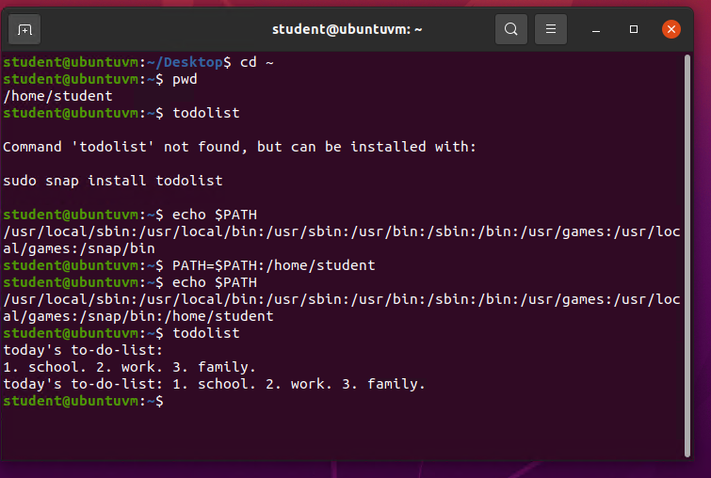
Set the PATH variable
Take a screenshot of the output in Step 6.

Slide 12
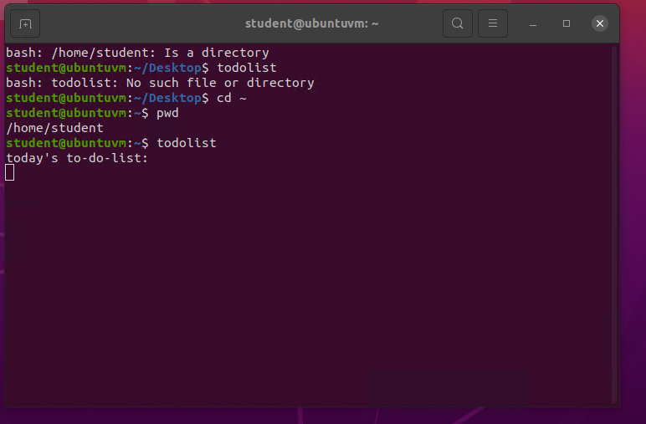
Make the PATH variable permanent
Run the todolist script before and after making the PATH variable permanent. Take a screenshot of both Terminal windows.

Slide 13
Operating Systems
Module 4 User and Group Management
This module goes over group settings and customization using the command line as well as using the GUI as well as adding and removing users from the machine as well as groups

Slide 14
Add users and groups in CLI
1. What does the –m option in the useradd command do?
Answer here: create home folder
2. What does the -3 option in the tail command do?
Answer here: 3 lines of data
3. Which line of the /etc/group file lists members of the “students” group? Copy it here.
Answer here: sudo tail -3 /etc/group

Slide 15
Test user and group settings
Take a screenshot of the output in Step 6.

Slide 16
Add users in GUI
Take a screenshot of the output in Step 9.

Slide 17
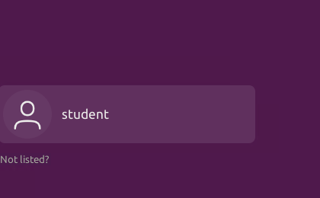
Remove users and groups
Take a screenshot of the log on page with three user accounts.
Take a screenshot of the log on page with only your user account (i.e., student).

Slide 18
Operating Systems
Module 5 Network Configuration
This project we go over discovery of our IP interface as well as managing our network interface including how to find out our personal IP address.

Slide 19
Discover host IP configurations
1. What is the IP address of your Ubuntu machine?
Answer here:192.168.1.103/24
2. What is the IP address of its default gateway?
Answer here:192.168.1.1
3. What is the IP address of its DHCP server?
Answer here:192.168.1.1
4. What is the IP address of its DNS server?
Answer here: 192.168.1.1
Take a screenshot of the output in Step 6.

Slide 20
Manage network interfaces
1. Which DHCP message is shown in the output of the sudo dhclient –v –r eth0 command? [hint: the message name is in uppercase.]
Answer here: DHCPRERELEASE
2. Which four DHCP messages are shown in the output of the sudo dhclient –v eth0 command? [hint: the message names are in uppercase.]
Answer here: DHCPDISCOVER DHCPOFFER DHCPREQUEST DHCPACK

Slide 21
Use network utilities
Take a screenshot of the output in Step 5.

Slide 22
Operating Systems
Module 6 System Performance Monitoring
This project goes over monitoring user activity as well as bandwidth usage and finding out what processes are running in the system

Slide 23
Monitor Linux processes
1. What is the default action of the 15 SIGTERM kill signal?
Answer here: terminate the program
2. In the System Monitor window, click on % CPU to sort the processes by CPU load. Which process shows the highest percentage of CPU usage?
Answer here:gnome shell/ system monitor

Slide 24
Monitor user activities
Issue the sudo accton on command to turn on GNC accounting. Run the sudo updatedb command. Enter lastcomm updatedb to check if the updatedb command was executed before. Remember to turn off GNC accounting (sudo accton off) after answering the questions.
1. What flag value is displayed in the output?
Answer here: user terminal and seconds
2. Why is the name of the user who ran the processes shown as root, not student?
Answer here: root is the name of administrator account

Slide 25
Monitor network bandwidth usage
Take a screenshot of the output in Step 4.

Slide 26
Thank you all
This has been a very pleasurable learning experience as we have gone through the virtual Linux tour and discovering many different functions and tasks we can accomplish on an entirely new operating system that probably not many of us are familiar with. There were troubles when it came to connecting to the network services but after some troubleshooting tips everything came together perfectly as planned.

