Slide 1
Introduction
Through this series of projects, we get more familiar with electrical components, as well as testing circuits using various tools. Through the help of computer applications, we can virtualize a simulation of the circuit we are testing and apply the correct measurement tools to the circuit to verify functionality.

Slide 2
ECT226 DeVry University Week 3 Project Deliverables DC Analysis: Series-Parallel Circuits
Name: Toohey, Charles
Session: Fall 2022

Slide 3
Series-parallel circuits
Through this series of the course, we can see how to calculate circuit parameters for a series-parallel circuit, we also use the Multisim application to build and troubleshoot our circuit. We use our multimeter to measure these parameters.

Slide 4
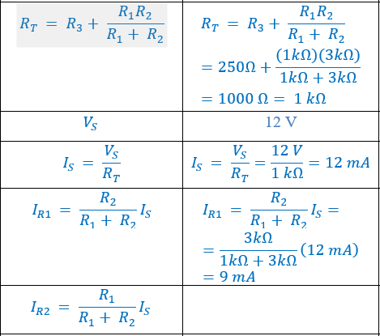
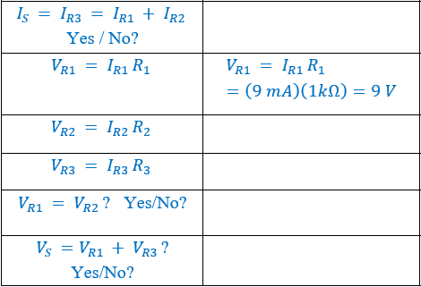
Formulas | Calculated Parameters from Part 1 (Unit) | Simulated Parameters from Part 2 (Unit)
 |  | 1.002kOhm
 |  | 12V
 |  | 12mA
 |  | 9mA
Table 1. Calculated and simulated
parameters of the series-parallel circuit

Slide 5
Paste TWO Pictures required by Part 2, step 5) to show how to measure the following parameters using the XMM:
Voltage across the resistor R₃ ,V_{R3}
b) Current through the resistor R₂, I_{R2}

Slide 6
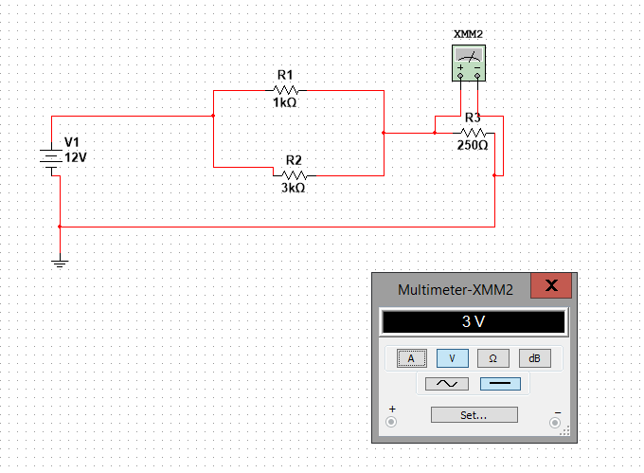
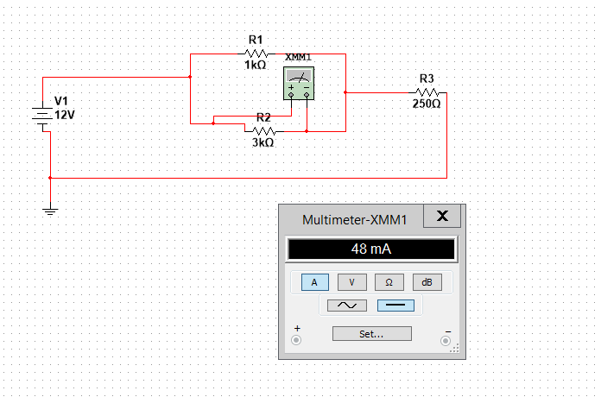
Screenshot of circuits showing multimeter readings

Slide 7
Fill the entries in Table 2:
Resistor with tolerance | Minimum Value (Ω) | Maximum Value (Ω)
100 Ω +10% | 100-(100*0.1)=90 | 100+(100*0.1)=110
100 Ω +5%
100 Ω +1%

Slide 8
ECT226 DeVry University Week 4 Project Deliverables AC Analysis: RC and RLC Circuits
Name: Toohey, Charles
Session: Fall 2022

Slide 9
RC RLC circuits
With this portion we can see how to calculate period and frequency of a sinusoidal signal, as well as magnitude and period using an oscilloscope with the help of the Multisim application. We also will measure the RMS value of the circuit with our multimeter.

Slide 10
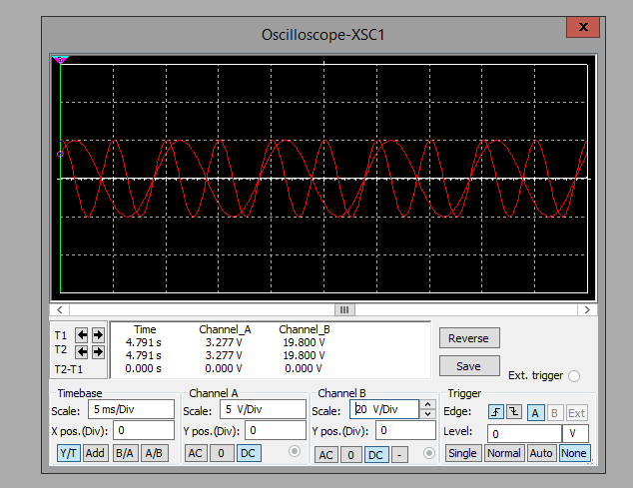
Paste the screen shot required by Part 1, step 13

Slide 11
Fill the table required by Part 1, steps 14 and 15
Table 1
Time Period (ms) | Peak Voltage (Vp) | Frequency (Hz)
10.133 ms | 4.991 | 1/10.133 ms

Slide 12
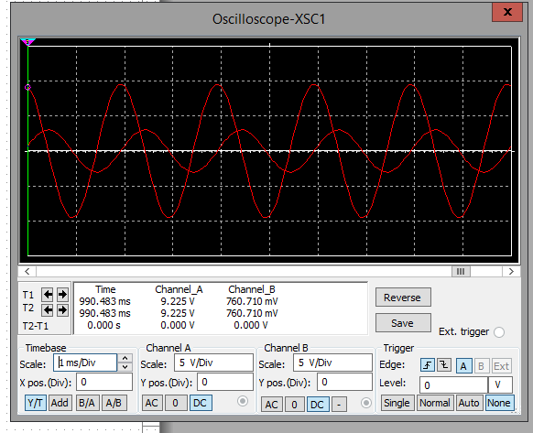
Paste the screen shot required by step 8, Part 2

Slide 13
Answer the questions in step 10, Part 2
Time difference between V_{R1} and V_{C1} = 511 µs
Time period for the signals = 2000 µs
Phase angle difference between V_{R1} and V_{C1} = 90 °

Slide 14
Fill the table required by steps 11 and 12, Part 2
Table 2
Signal | Peak Voltage V_{P} (V) | RMS Voltage V_{RMS} (V)
V_{R1} | 9.225v | *0.707 =6.522v
V_{C1} | 3.014v | *0.707= 2.13v

Slide 15
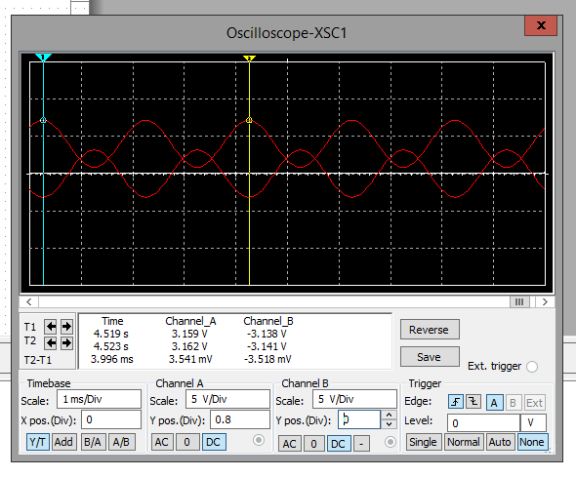
Paste the screen shot required by step 4, Part 3

Slide 16
Answer the questions in step 5, Part 3
Time difference between V_{C1} and V_{L1} = 1.042µs
Time period of the signals T = µs
Phase angle difference between V_{C1} and V_{L1} = _______ °

Slide 17
Fill the table required by steps 7 and 8, Part 3
Table 3
Signal | Peak Voltage V_{P} (V) | RMS Voltage V_{RMS} (V)
V_{C1} | 3.159v | *0.707= 2.233v
V_{L1} | 3.141v | *0.707=2.22v

Slide 18
ECT226 DeVry University Week 5 Project Deliverables Transistor Amplifiers
Name: Toohey, Charles
Session: Fall 2022

Slide 19
Transistor amplifier
Through this part of the project, we can see how to calculate voltage gain of an amplifier in our electrical circuit. We will measure the input and output signals using our oscilloscope in the Multisim tool.

Slide 20
Fill the table required by steps 5 to 7:
Table 1
V_{in} (mV) | V_{out} (mV) | Av | Phase Difference Between V_{in} and V_{out}
79.240mV | 8.973mV | 122 | 180 degree

Slide 21
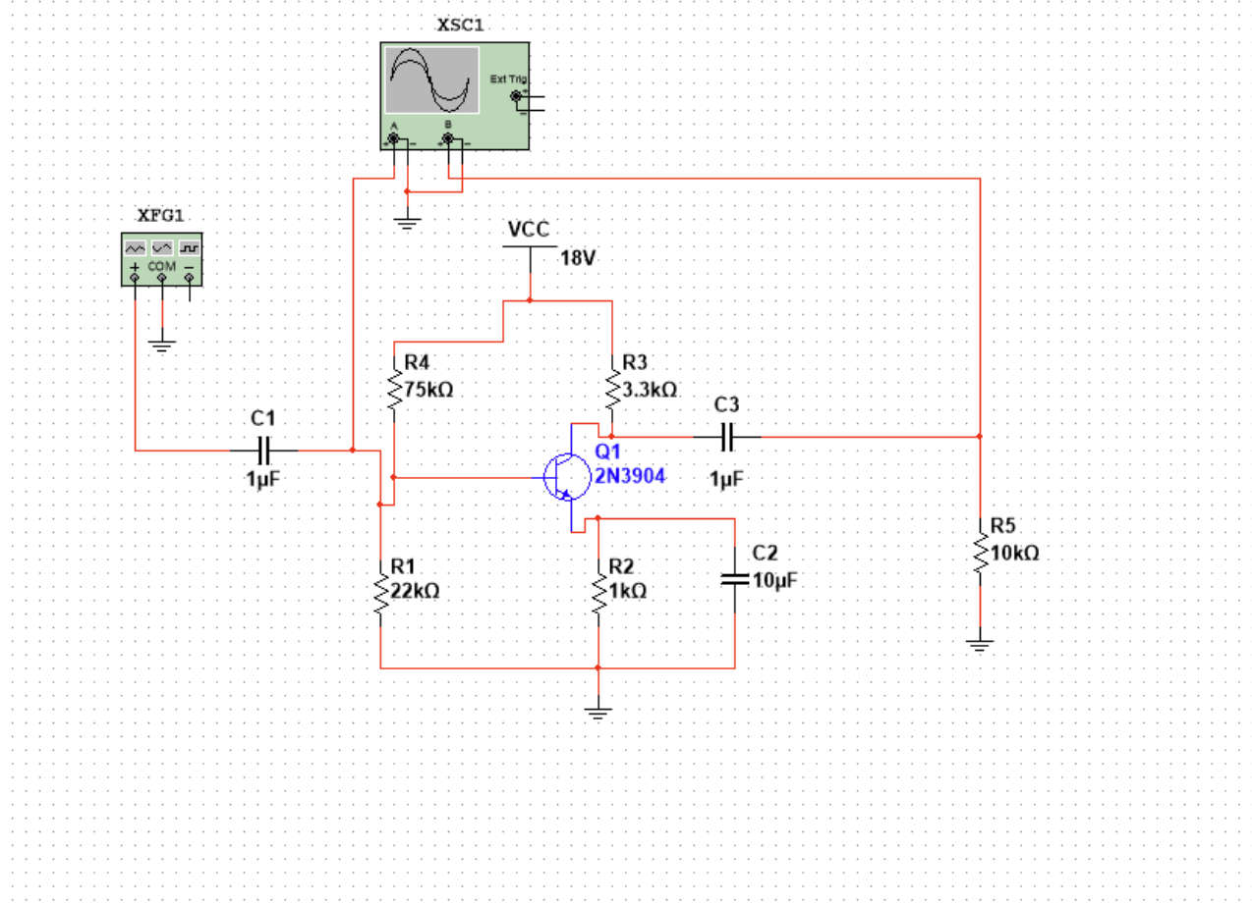
Paste the screen shot from step 9 - The BJT amplifier circuit schematic

Slide 22
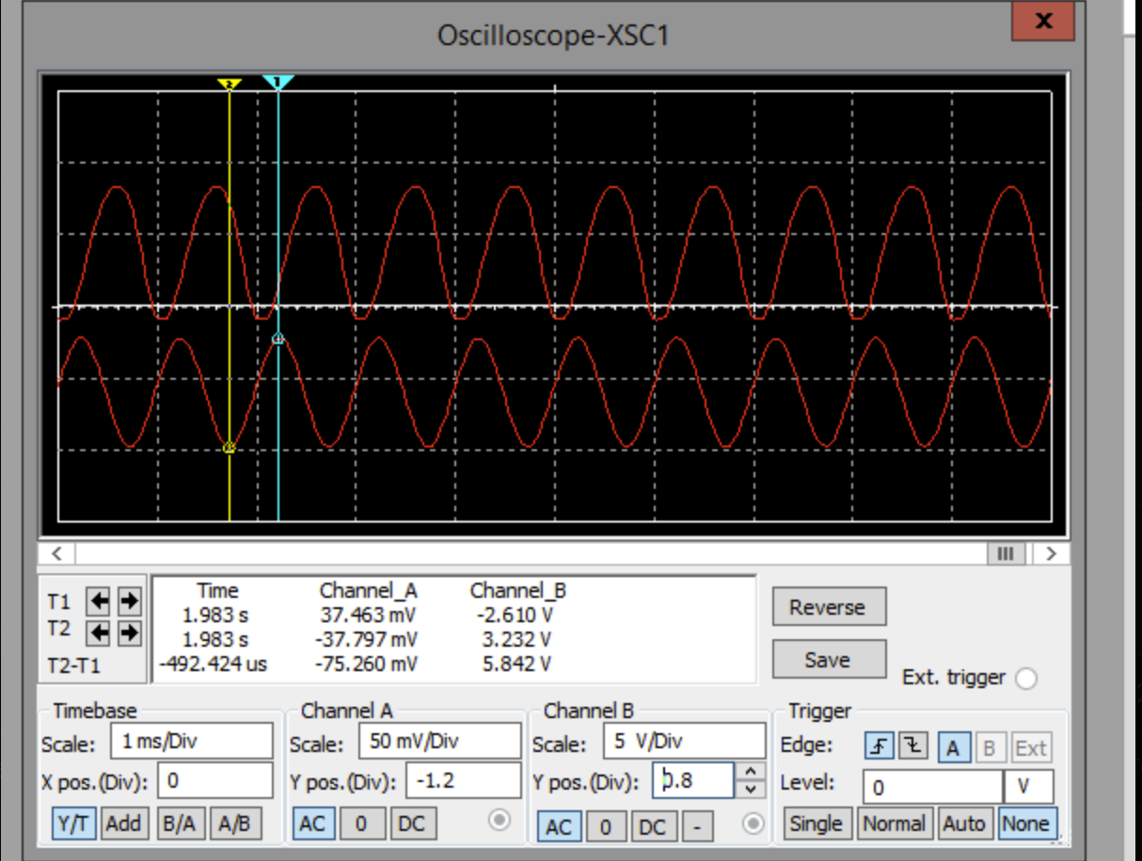
Paste the screen shot from 9 - The simulation results displayed on the XSC1 with proper settings:

Slide 23
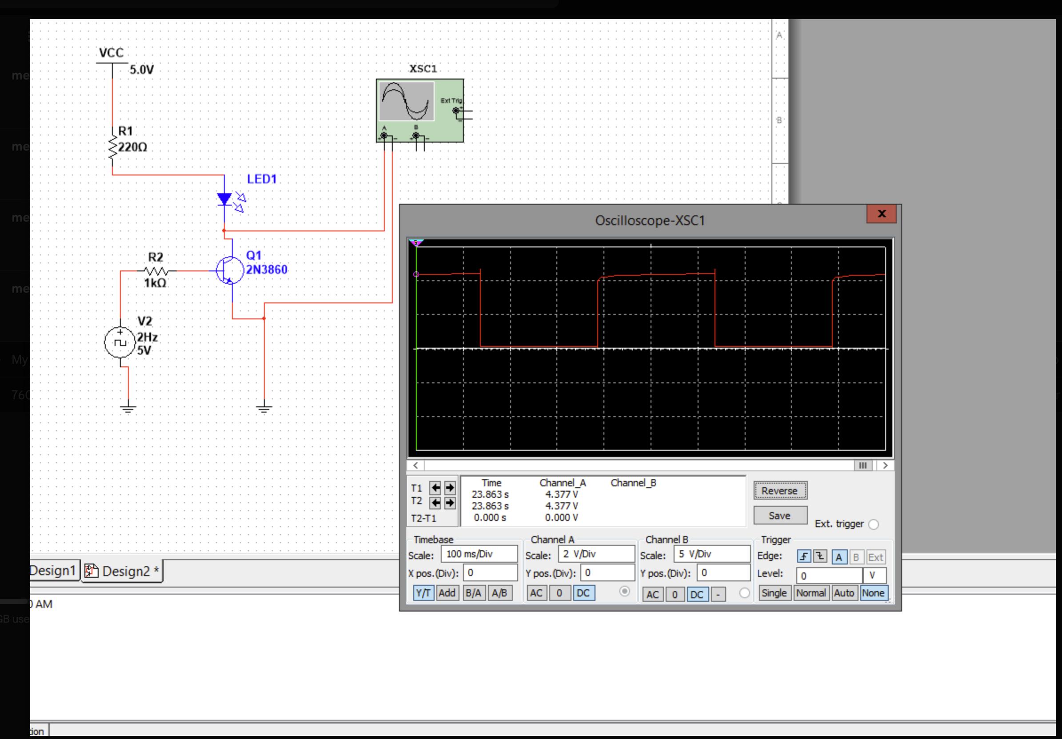
Paste the screen shot required by Part 2, step 4

Slide 24
Conclusion:
In this project we can see how transistors function in different circuits. In the second circuit we can see the transistor being used to turn on or off the led indicator. In the first portion we can see how we use the transistor in a circuit to be able to change the voltage of the circuit.

Slide 25
ECT226 DeVry University Week 6 Project Deliverables Summing Amplifiers
Name: Toohey, Charles
Session: Fall 2022

Slide 26
Summing amplifier
Continuing on with amplifiers, this section we learn how to build and analyze the summing amplifier and how it operates. We use our Multisim tool as well to build our circuits.

Slide 27
Write the Vout formula here required by step 1)
Vout = -(V1+V2+V3)

Slide 28
Paste the simulation circuit with the output displayed on the XMM1, step 3)

Slide 29
Paste the XMM1 reading from the simulation, step 4)

Slide 30
Paste the XMM1 reading from the simulation, step 5)

Slide 31
Paste the screen capture of the 4-channel oscilloscope display with the settings, step 11)

Slide 32
Paste the screen capture of the 4-channel oscilloscope display with the settings, step 14)

Slide 33
Conclusion
This class has taught me a lot about different electrical components and how they operate inside of an electrical circuit in order to make it perform correctly. I look forward to learning more.

