Slide 1
CEIS101
Module 6
Adding Automated Light to Smart Home System

Slide 2
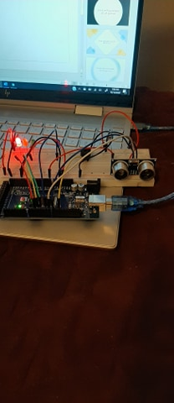
Circuit with automated LED off (picture)

Slide 3
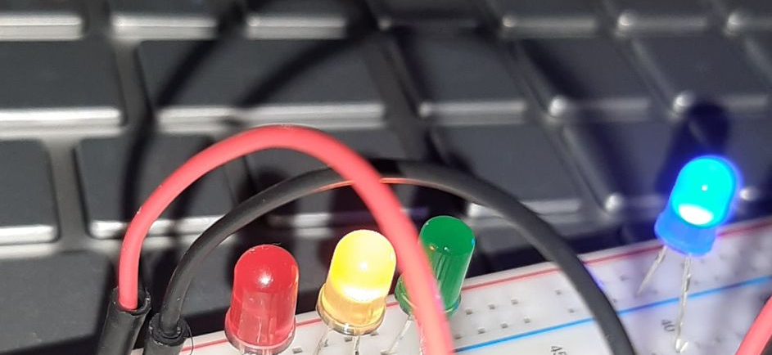
Circuit with automated LED on (picture)

Slide 4
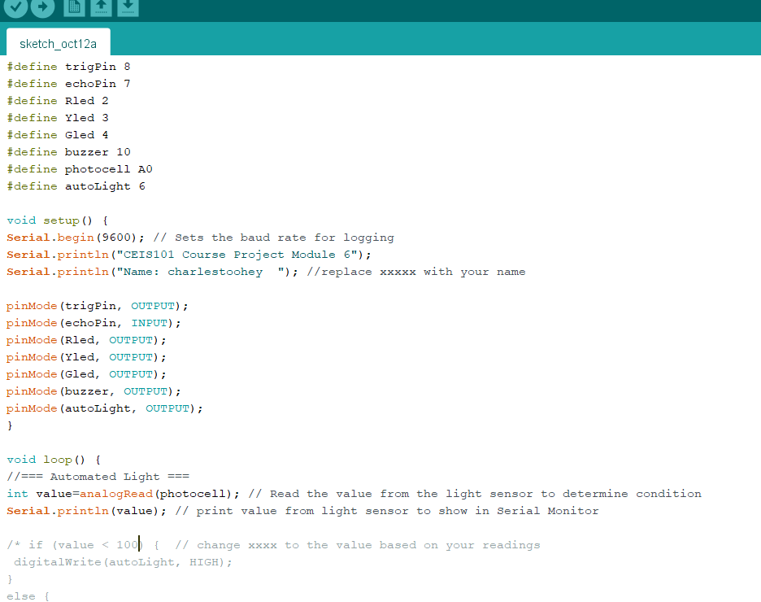
Arduino Code (screenshot)

Slide 5
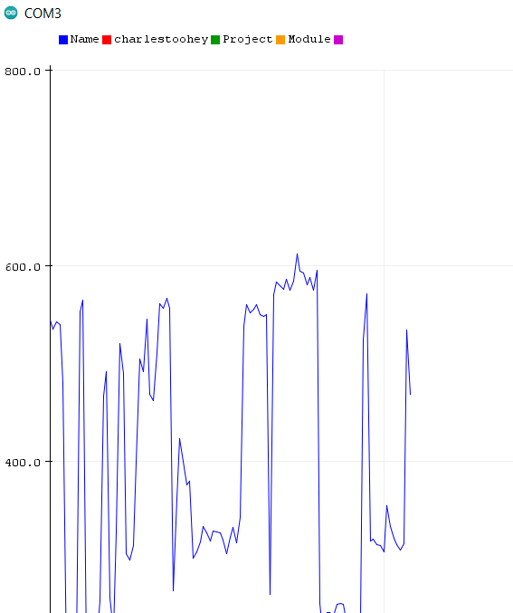
Serial Plotter (screenshot)

