Slide 1
Course Project
Operating Systems
Module 5 Network Configuration

Slide 2
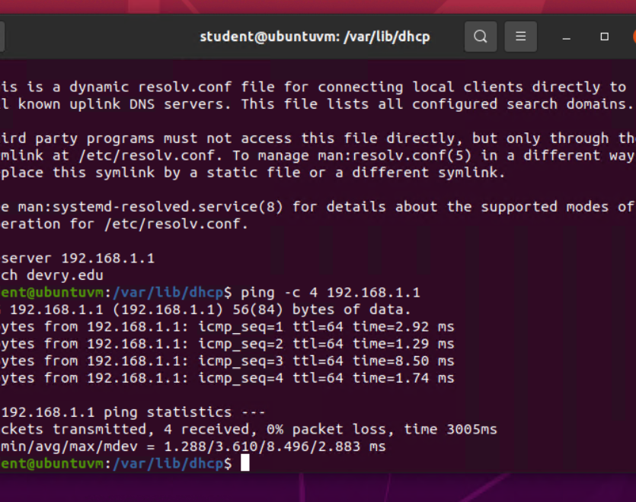
Discover host IP configurations
1. What is the IP address of your Ubuntu machine?
Answer here:192.168.1.103/24
2. What is the IP address of its default gateway?
Answer here:192.168.1.1
3. What is the IP address of its DHCP server?
Answer here:192.168.1.1
4. What is the IP address of its DNS server?
Answer here: 192.168.1.1
Take a screenshot of the output in Step 6.

Slide 3
Manage network interfaces
1. Which DHCP message is shown in the output of the sudo dhclient –v –r eth0 command? [hint: the message name is in uppercase.]
Answer here: DHCPRERELEASE
2. Which four DHCP messages are shown in the output of the sudo dhclient –v eth0 command? [hint: the message names are in uppercase.]
Answer here: DHCPDISCOVER DHCPOFFER DHCPREQUEST DHCPACK
References:
1.
2.

Slide 4
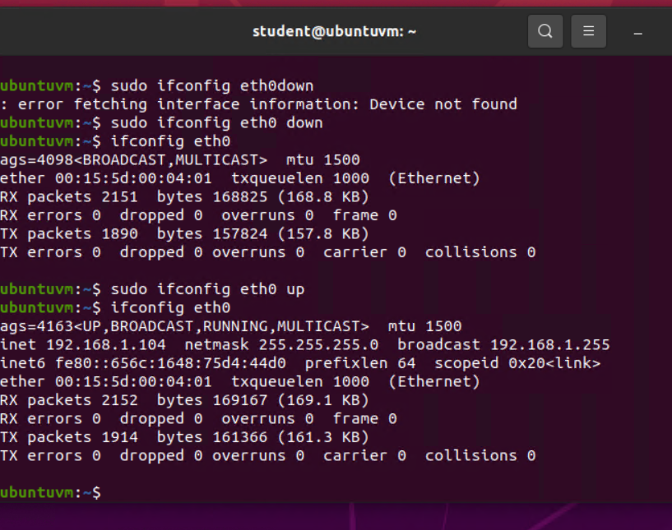
Use network utilities
Take a screenshot of the output in Step 5.

