Slide 1
Course Project
Operating Systems
Module 3 Linux Shell Scripts

Slide 2
Create a shell script
1. What are the file permissions of the script?
Answer here: read write no execute
2. What’s the name of the user-defined variable in the script?
Answer here: text
3. Which redirection meta-character is used in the script? What does it do?
Answer here: >> redirection
References:
1.
2.

Slide 3
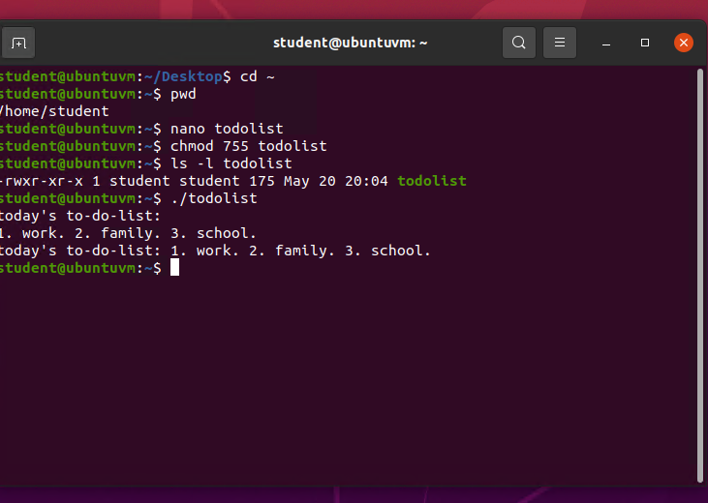
Change script file permissions
Take a screenshot of the output in Step 5.

Slide 4
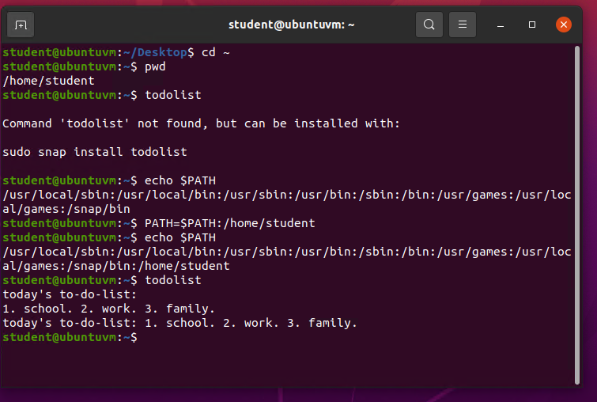
Set the PATH variable
Take a screenshot of the output in Step 6.

Slide 5
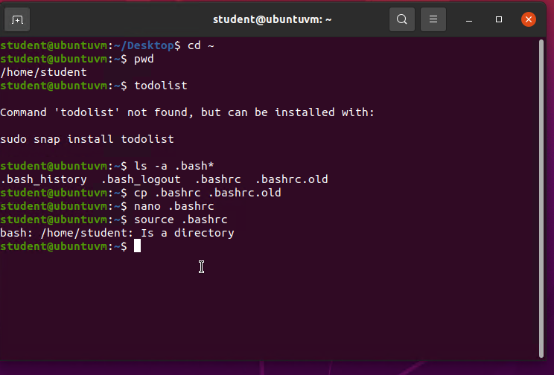
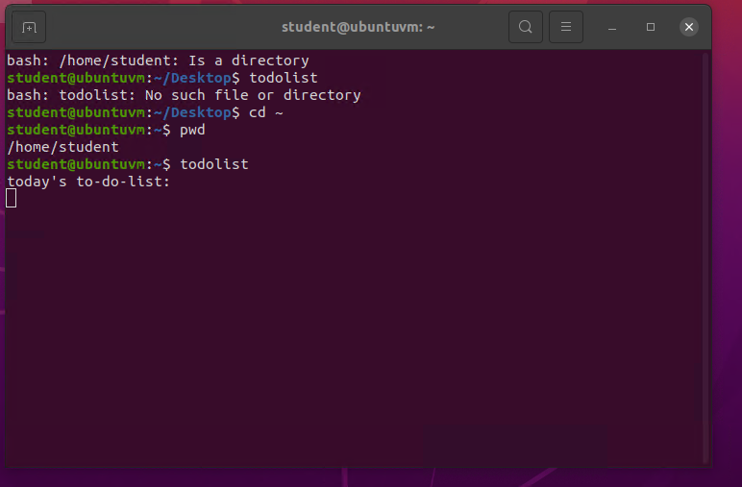
Make the PATH variable permanent
Run the todolist script before and after making the PATH variable permanent. Take a screenshot of both Terminal windows.

