Slide 1
Course Project
Operating Systems
Module 4 User and Group Management

Slide 2
Add users and groups in CLI
1. What does the –m option in the useradd command do?
Answer here: create home folder
2. What does the -3 option in the tail command do?
Answer here: 3 lines of data
3. Which line of the /etc/group file lists members of the “students” group? Copy it here.
Answer here: sudo tail -3 /etc/group
References:
1.
2.

Slide 3
Test user and group settings
Take a screenshot of the output in Step 6.

Slide 4
Add users in GUI
Take a screenshot of the output in Step 9.

Slide 5
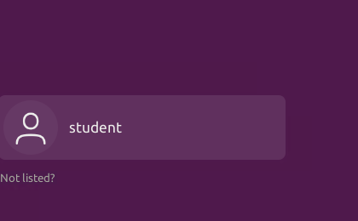
Remove users and groups
Take a screenshot of the log on page with three user accounts.
Take a screenshot of the log on page with only your user account (i.e., student).

