Slide 1
PHYS204
Charles Toohey 06/23/2022
DeVry University
Instructor: Dr. Adib
Throughout this Lab we go through the research phase of using the Arduino Mega board as well as the ESP32 board to monitor the sensor reading from our ultrasonic sensor, our rotary encoder, as well as our ESP32 built in Hall Effect sensor. We use these measurements to determine the force, magnitude, Gravitational Acceleration, as well as rotational motion in relevance to the object we use.

Slide 2
PHYS204 Module 1
Materials List

Slide 3
Materials List (Picture)
Mega 2560 Board
Ultrasonic sensor HC-SR04
Male to Male Wires
Breadboard
USB cable
Ruler or tape measurer
Object to act as obstacle and/or undergo free-fall

Slide 4
Materials List (Picture)
Mega 2560 Board
Rotary Encoder Module KY-040
Male to Female Wires
USB cable
Object to attach onto rotary encoder
Ruler or tape measurer

Slide 5
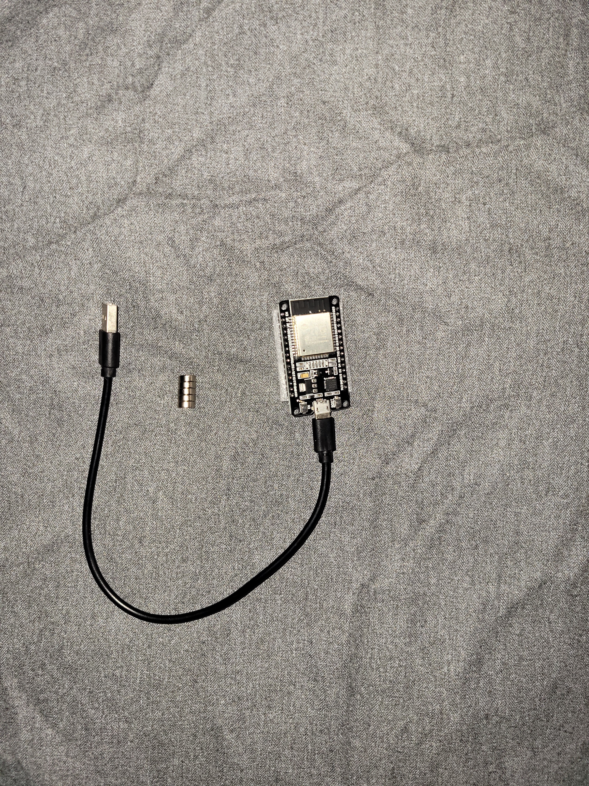
Materials List (Picture)
ESP32 microprocessor
Micro-USB to USB cable
Magnet

Slide 6
Required Software (screenshot)
Microsoft Excel installed and running on your computer

Slide 7
Required Software (screenshot)
Arduino IDE installed and running on your computer

Slide 8
Ultrasonic sensor testing
In this section we have compiled all our materials so now it is time to collect some measurements and data from conducting our experiment.

Slide 9
PHYS204 Module 2
Precision of the Ultrasonic Sensor

Slide 10
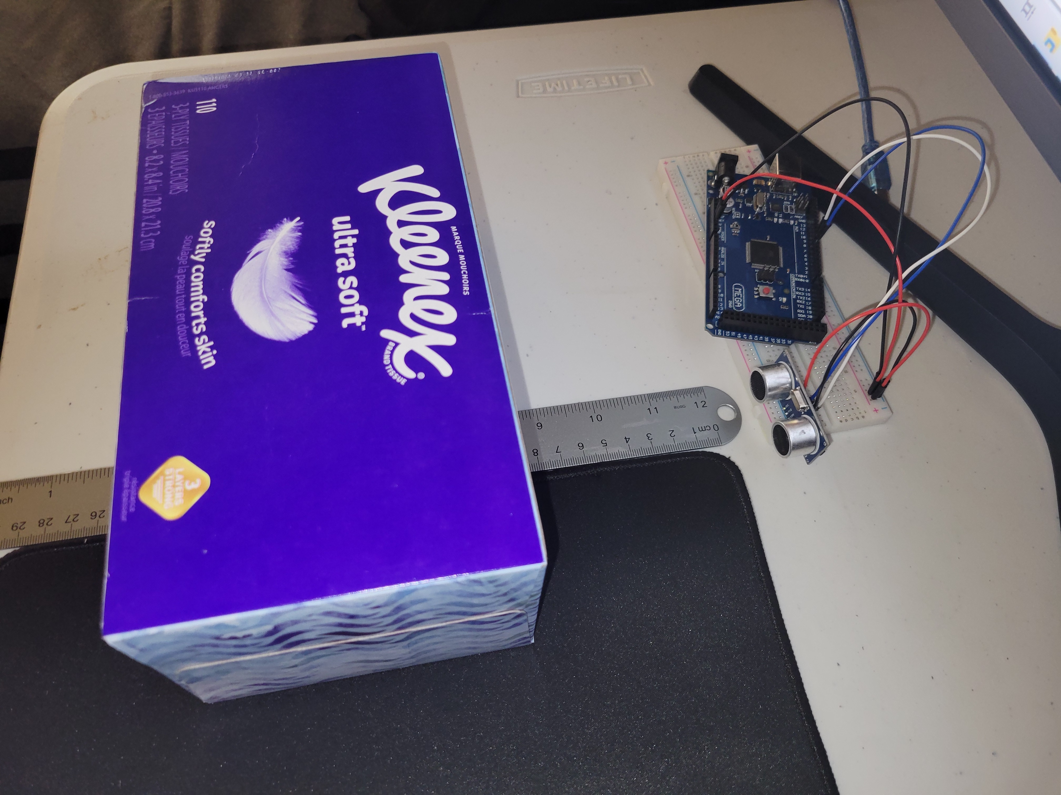
Experimental Set-up (Picture)
Materials List:
Mega 2560 Board
Ultrasonic sensor HC-SR04
Male to Male Wires
Breadboard
Ruler or tape measurer
Object to act as obstacle

Slide 11
Raw Data (Screenshot)
Screenshot of Serial Monitor from Arduino IDE showing raw data.
Must include your name displayed in the serial monitor.

Slide 12
Data Collection
Trial | Ruler Distance (cm) | Total Roundtrip Distance (m) | Time from Serial Monitor (microseconds) | Roundtrip time (s) | Velocity = distance/time (m/s)
1 | 7 | 0.14 | 473 | 4.73e-4 | 296
2 | 9 | 0.18 | 605 | 6.05e-4 | 298
3 | 11 | 0.24 | 745 | 7.45e-4 | 322
4 | 14 | 0.28 | 946 | 9.46e-4 | 296
5 | 17 | 0.34 | 1142 | 11.42e-4 | 298

Slide 13
Data Analysis
Average velocity from table
302 m/s
Percent difference where $v_{sound}=343 m/s$
$$v_{avg}= \frac{v_{1}+v_{2}+v_{3}+v_{4}+v_{5}}{5}=$$
$$Percent difference = \frac{\left|v_{avg}−v_{sound}\right|}{v_{sound}}×100\%=$$
11.95%
Note: Use meters and seconds for all calculations. Show the appropriate units for measured and calculated values

Slide 14
Conclusions
Discuss the results and comment on the source of errors.
Answer: Some error points would be making sure connections are secure as well as making sure to orient voltage correctly. The results of my experiment show that the ultrasonic sensor differs only slightly at around 11 percent difference. Have to use a large enough object for the sensor.
What is the dependence of temperature, humidity and atmospheric pressure on the speed of sound?
Answer: The speed of sound is influenced by many things, higher temperature makes sound move faster, due to the molecules moving faster.

Slide 15
Falling object experiment
Through this portion we can use an object and drop it, and using the ultrasonic sensor, we can monitor the object’s acceleration and compare it to the speed of sound to tell us how accurate our sensor is.

Slide 16
PHYS204 Module 3
Gravitational Acceleration

Slide 17
Experimental Set-up (Picture)
Materials List:
Mega 2560 Board
Ultrasonic sensor HC-SR04
Male to Male Wires
Breadboard
Object to undergo free fall motion

Slide 18
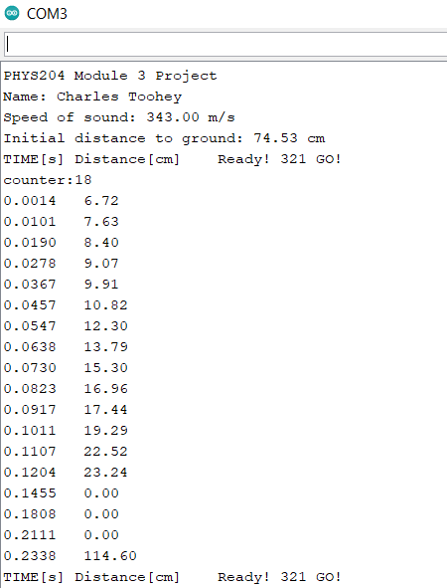
Serial Monitor (Screenshot)
Include screenshot of raw data showing the start of the fall and end of the fall of one trial.
Must include your name displayed in the serial monitor.

Slide 19
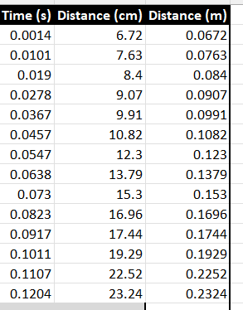
Excel Table (Screenshot)
Include all values in the Excel table for a single trial showing the fall distance in centimeters and meters as a function of time

Slide 20
Excel Graph (Screenshot)
Include Excel graph for a single trial showing the fall distance as a function of time.
Must include equation for curve fitting.

Slide 21
Data Collection
Trial | x² coefficient value from curve fitting | Acceleration (m/s²) = 2* (x² coefficient)
1 | 3.79 | 7.58
2 | 4.01 | 8.02
3 | 4.22 | 8.44
4 | 4.37 | 8.74
5 | 5.65 | 11.3

Slide 22
Data Analysis
Average acceleration from table
8.816
Percent difference with $g=9.8 m/s^{2}$ 10.2% difference
$$a_{avg}= \frac{a_{1}+a_{2}+a_{3}+a_{4}+a_{5}}{5}$$
$$Percent difference =\frac{\left|a_{avg}−g\right|}{g}×100\%=$$
Note: Use meters and seconds for all calculations. Show the appropriate units for measured and calculated values

Slide 23
Conclusions
Discuss the results and comment on the source of errors.
Answer: The results show a roughly 10 percent difference with the speed of sound. Needed to figure out a suitable angle for the sensor, as well as a large enough object to be able to be detected by the sensor.
How much variation is there from trial to trial? What does this indicate about the uncertainty of the result?
Answer: The slight variation from trial to trial shows us that the sensor is stable, but not enough to provide a more precise conclusion.

Slide 24
FALL DISTANCE ENERGIES
With our data from the previous portion we can compile it to a plot chart to give us a better graphical representation of Kinetic, Potential, as well as total energy from our falling object. This will help us to get a better understanding of how the object will react to differing circumstances such as wind, obstructions, or any other variables.

Slide 25
PHYS204 Module 4
Conservation of Energy

Slide 26
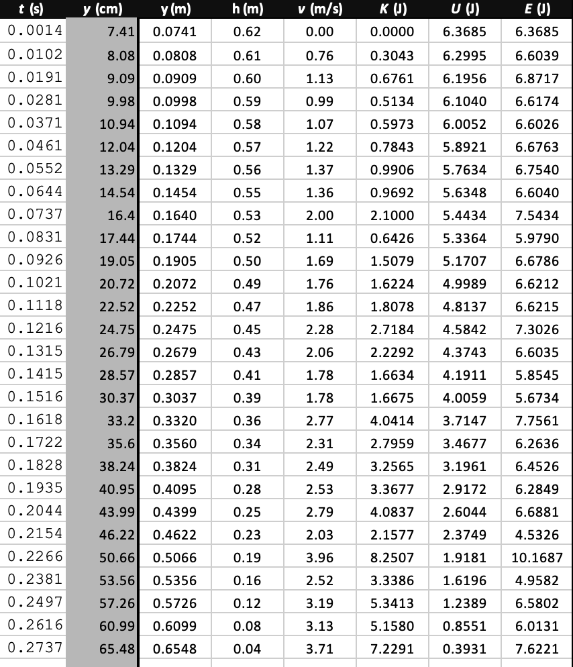
Excel Table (Screenshot)
Include all values in the Excel table for a single trial showing the fall distance in centimeters and meters as a function of time with the values generated for kinetic energy K, potential energy U, and total mechanical energy E.

Slide 27
Excel Graph (Screenshot)
Include Excel graph for a single trial showing the plots of the kinetic energy K, potential energy U, and total mechanical energy E as a function of time.
Must include your name in the title of the graph.

Slide 28
Data Validation
Final velocity from experimental data (largest velocity)
3.96M/S
Theoretical value of final velocity.
$h=y_{final}−y_{initial}=$0.6548M-0.0741M= 0.5807M
= = 3.37M/S
Percent difference
$v_{experimental}$ =
$v_{f}=\sqrt{2gh}$ =
$Percent difference =\frac{\left|v_{f}−v_{experimental}\right|}{v_{f}}×100\%=$ $\frac{\left|3.37m/s−3.96m/s\right|}{3.37m/s}×100\%=17\%$
Note: Use meters and seconds for all calculations. Show the appropriate units for measured and calculated values

Slide 29
Conclusions
Discuss the key characteristics of the plot. Consider the times when U is max and min, when K is max and min, and when U and K are the same value. What is the significance of these points?
Answer: Reference to the chart we can see that the Kinetic energy is at the lowest points when potential energy is at its highest points. We also see that the Potential energy is at the lowest points when the kinetic energy is at the highest points. We can see as the object is falling it is increasing speed.

Slide 30
Conclusions
What is the trend of the best fit line for the total energy E in your data? If the data is accurate, the total mechanical energy should decrease slightly. Why is that?
Answer: The total energy is represented by the chart to be fairly in line with the kinetic energy.
The total mechanical energy should decrease slightly due to air resistance or any other friction or force acting upon the object.

Slide 31
Rotary encoder
In this module we use our rotary encoder to tell us the rotational motion of an object we have attached to our rotary encoder, in my example I used a bottle cap

Slide 32
PHYS204 Module 5
Rotational Motion

Slide 33
Experimental Set-up (Picture)
Materials List:
Mega 2560 Board
Rotary Encoder Module KY-040
Male to Female Wires
Object to attach onto rotary encoder (e.g. cork, bottle cap, ball)
Ruler or tape measurer

Slide 34
Raw Data (Screenshot)
Screenshot of Serial Monitor from Arduino IDE showing raw data.
Must include your name displayed in the serial monitor.

Slide 35
Data Collection
Object diameter: d = 2.8CM
Object radius: r = 1.4CM
Number of pulses for one revolution: x = 30
Resolution = $\left(\frac{1 }{40 } \frac{Revolution}{pulses}\right)∙\left(\frac{2∙π radians}{1 Revolution}\right)=0$.209 radians/pulse

Slide 36
Data Analysis
Trial | Number of pulses N | Encoder distance r$∙Resolution∙$ N | Measured distance with ruler | Percent difference %
1 | 243 | 71.10cm | 71cm | 0.1%
2 | 89 | 26.04cm | 30cm | 14.1%
3 | 130 | 38.04cm | 45cm | 16.8%
4 | 30 | 8.78cm | 10cm | 13%
5 | 182 | 53.25cm | 63cm | 16.8%

Slide 37
Conclusions
Discuss the results and comment on the reasons for errors.
Answer: The results show a fair amount of accuracy but not quite. This may be due to a traction issue. I ended up wrapping the bottle cap with electrical tape sticky side out to help with this but the results still show a variance.
What are some applications of this measuring technique? Could this measuring system be used to measure surfaces that are not flat?
Answer: I believe this could be implemented in circumstances that don’t require precision accuracy, I believe this could be useful in measuring surfaces that are not flat.

Slide 38
HALL EFFECT
This hall effect sensor will give us a varying value when it senses a magnetic force, this value will change varying on the polarization of the magnet as well as the distance from the sensor.

Slide 39
PHYS204 Module 6
Hall Effect

Slide 40
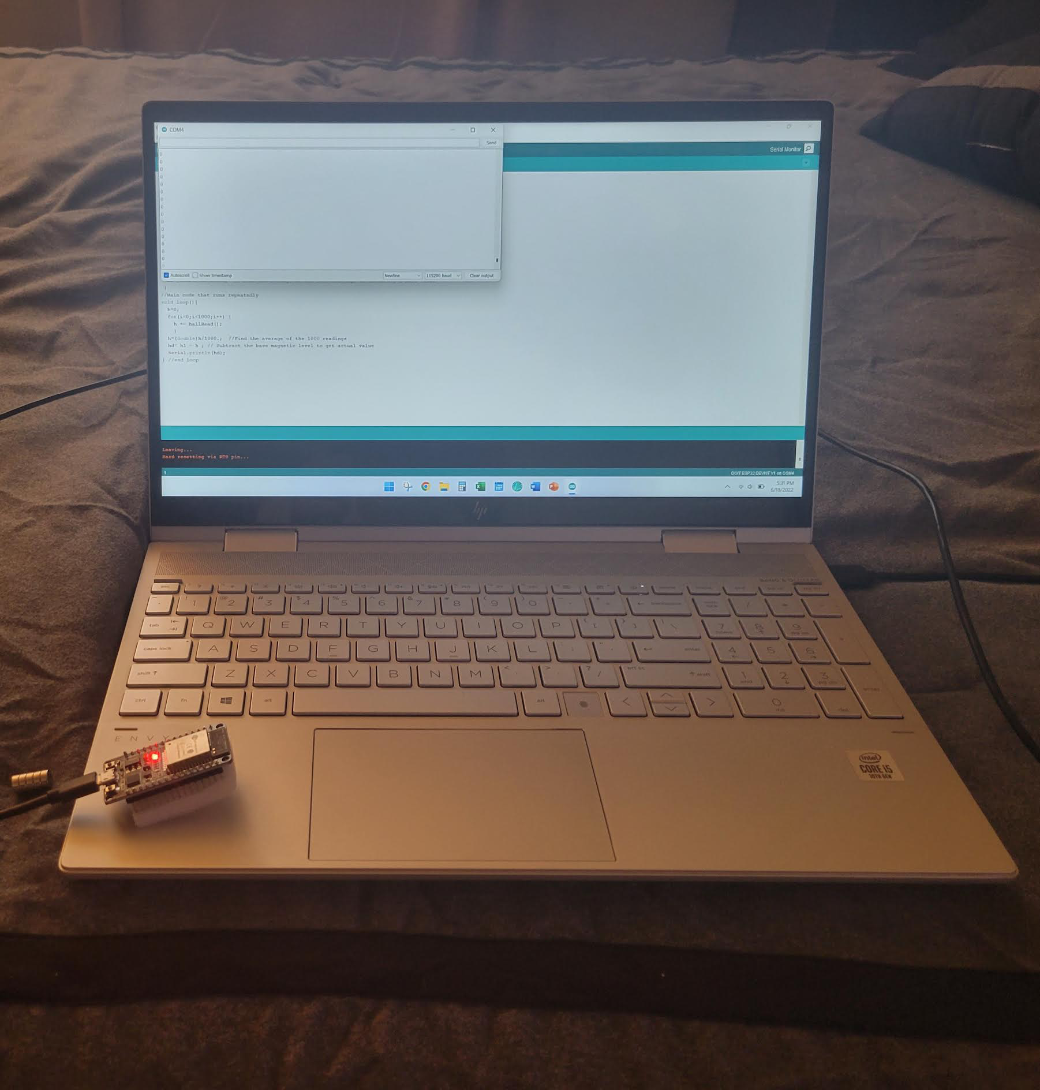
Experimental Set-up (Picture)
Materials List:
ESP32 microprocessor
Micro-USB cable
Magnet

Slide 41
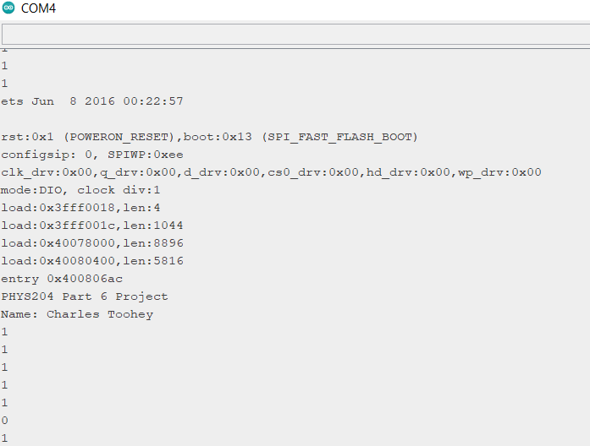
Raw Data (Screenshot)
Screenshot of Serial Monitor from Arduino IDE showing raw data.
Must include your name displayed in the Serial Monitor.
Unselect “Autoscroll” and scroll all the way up.

Slide 42
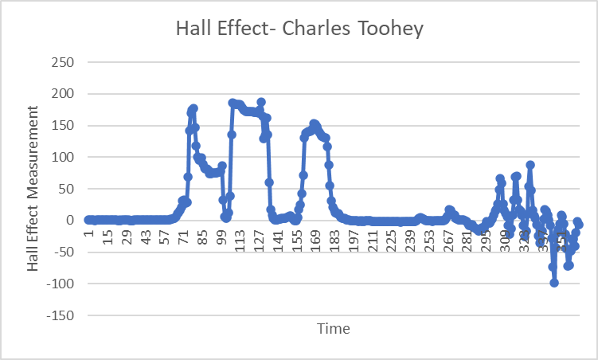
Data Analysis (Screenshot)
Screenshot data plotted in Excel.

Slide 43
Conclusions
Discuss the results and comment on how the Hall sensor works.
Answer: The results show values when a magnet gets close enough to this sensor.
What are some applications for the Hall effect sensor?
Answer: Some applications may include sorts of automation such as alerting you when you leave a door open, the magnet being affixed to the door, and sensor attached to the frame

Slide 44
Thank you!
This course has been quite fun, as well as challenging. We used a variation of sensors, computing hardware, and software to give us information regarding distance, velocity, and energy.
Some of the challenges I faced was making sure to double check my equations. I also ran into a few issues with the Arduino software but after a few updates it was fixed. This was a very enjoyable project. Technology is advancing and we can see just how much we can accomplish with these simple microcontrollers.

