Slide 1
Ceis 110 Programming with Data
Charles Toohey
02-16-2022

Slide 2
Introduction
Data is growing exponentially with increasing demands.
This project will show how we were able to use a cloud-based system to gather and use temperature and humidity data.
We will then analyze this data using programming and data analytics.

Slide 3
Software inventory
Before we can develop the program, we must first download and install all appropriate software.
Software necessary includes SQLite studio, Excel, and Python IDE- Anaconda.

Slide 4
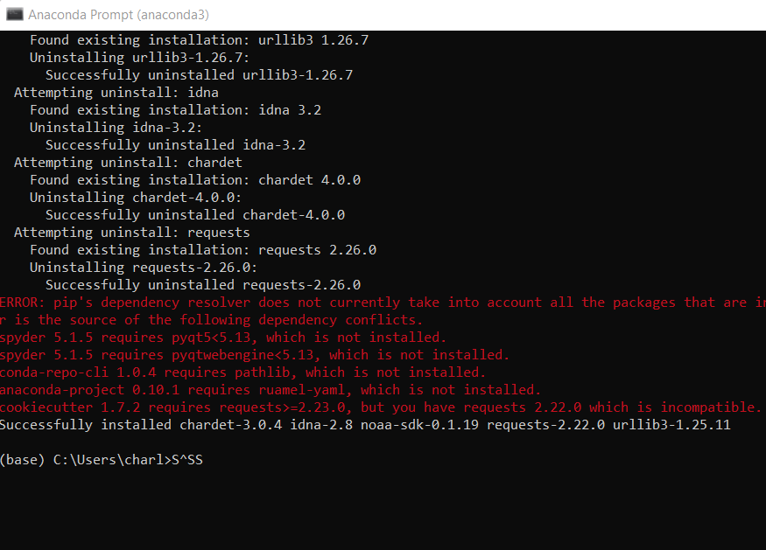
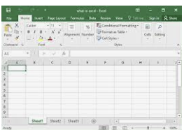
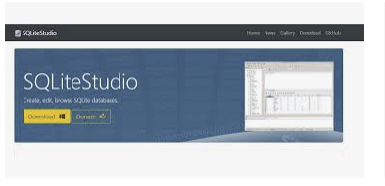
Software
Microsoft Excel
SQLite
Anaconda Navigator with Spyder

Slide 5
Plan and design
After we have prepared with our software installation, we can move to the planning stage of our project.
To plan the design of the project we use a flowchart to visualize the steps needed.
Planning and design stage is crucial to understand the development process.

Slide 6
What are flowcharts
A flowchart is a graphical representation of a process or workflow, and our flowchart illustrates the process and the output of this software development process.
Many companies use flowcharts as simple narratives.

Slide 7
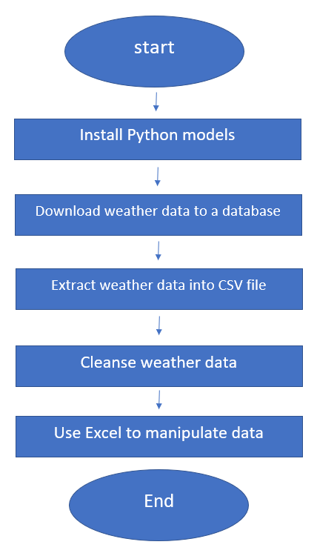
Flowchart
Install Python
Download weather data to a database
Extract weather data from database into a comma separated file with Python.
Cleanse weather data
Use excel to manipulate data
Use python data analytics modules to develop graphical models

Slide 8
Adding library for weather data
For us to interact with the US government National Oceanic and Atmospheric Administration (NOAA) weather data service using a cloud-based Application Programming Interface (API), we must install the library module to use the service.
Screenshot will show the NOAA-SDK library installed on our Spyder prompt.

Slide 9
Gathering temperature and humidity data
After planning and design we must develop the code to download a set of weather observations.
We must store this data on a local database in a table for further analysis.

Slide 10
Build weatherDb.py file in spyder
Screenshot of our code in spyder
This code will create a table named Observations with fields:timestamp, windspeed,temperature,relativehumidity, winddirection, barometricpressure, visibility and textDescription.
The database will be named weather.db and stored in the same directory with our Python code

Slide 11
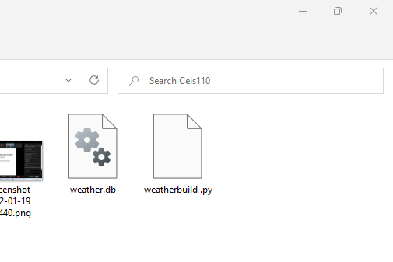
Weather db file
Screenshot of windows explorer showing the database file weather.db was created

Slide 12
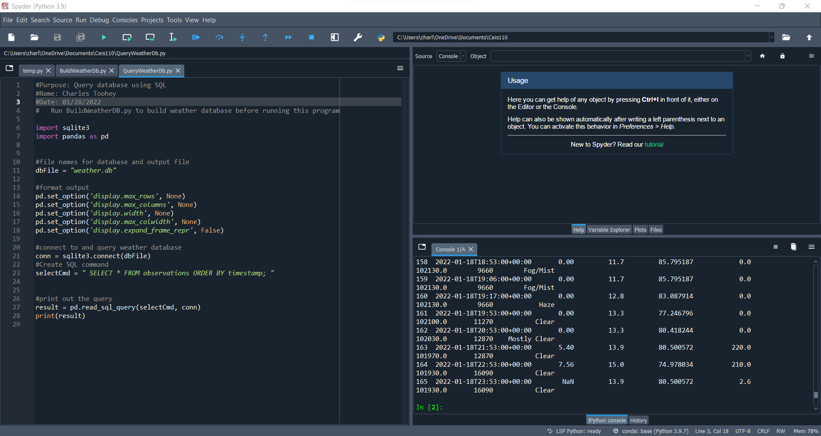
Querying the Database to retrieve all rows and collums
Structured Query logic (SQL) is a programming language used for working with relational databases.
SQLLiteStudio was used to query to database and view the results.
The SQL command “select* from observations” was executed to retrieve all rows and collums from the observation table.

Slide 13
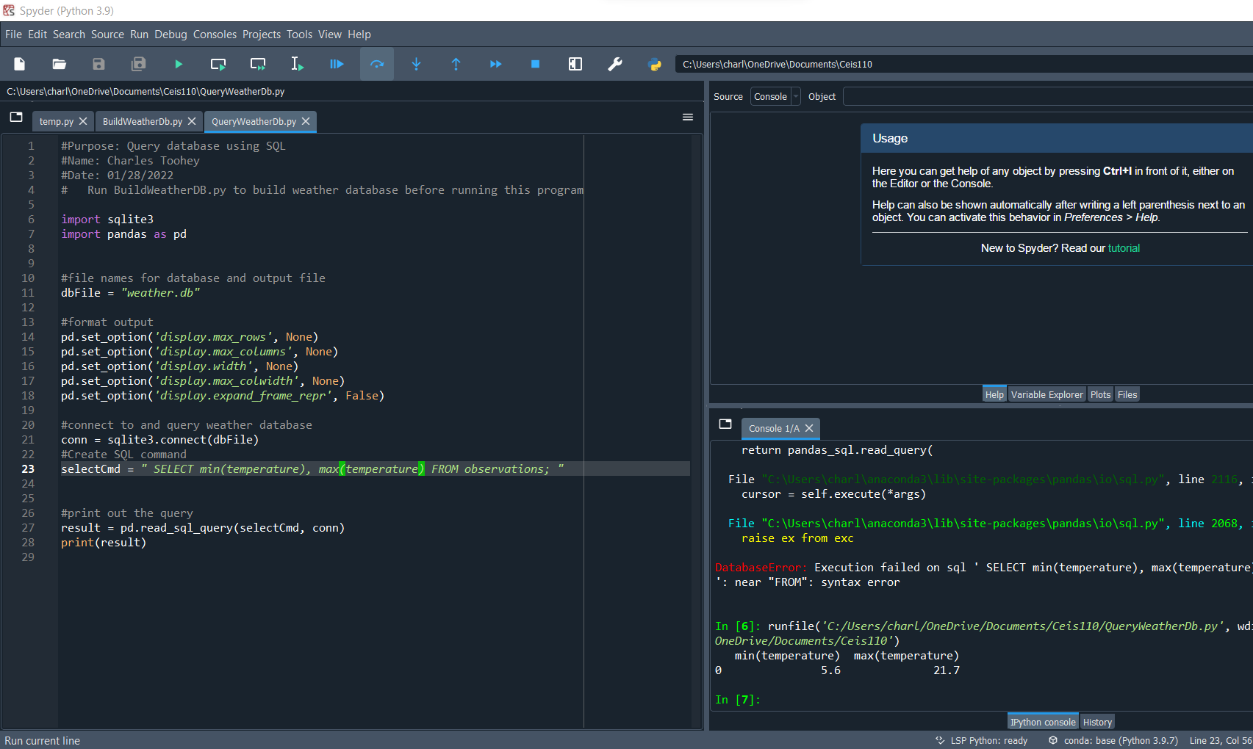
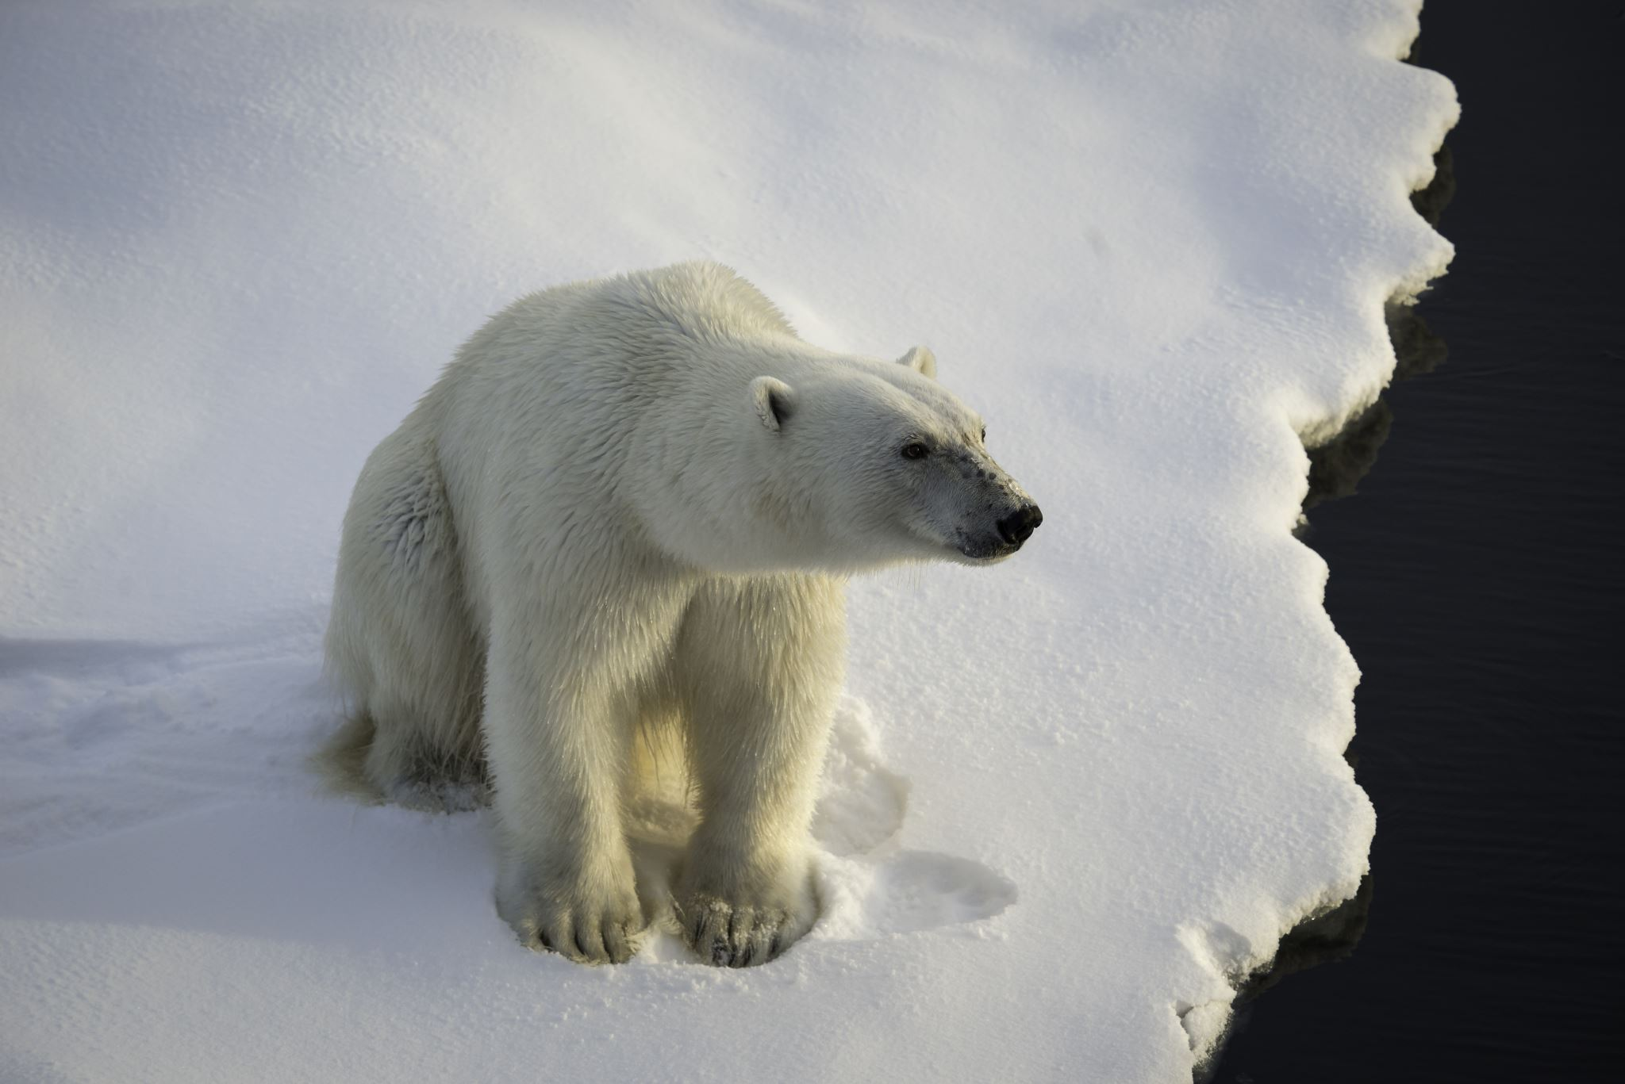
Query to retrieve min max temperature
The minimum and maximum temperatures were retrieved. These temperatures are captured based on Celsius scale.
Screenshot of code used.

Slide 14
Data cleansing
Data output from machines may have some errors or null data. When we cleanse this data programs can automatically put it all in the correct format to be able to be read by other programs.
A Python program reading in the data output by the Python program and saving it to a csv file so we can read it through Excel.
We must cleanse the data of missing or null values so that all data is uniform and complete.

Slide 15
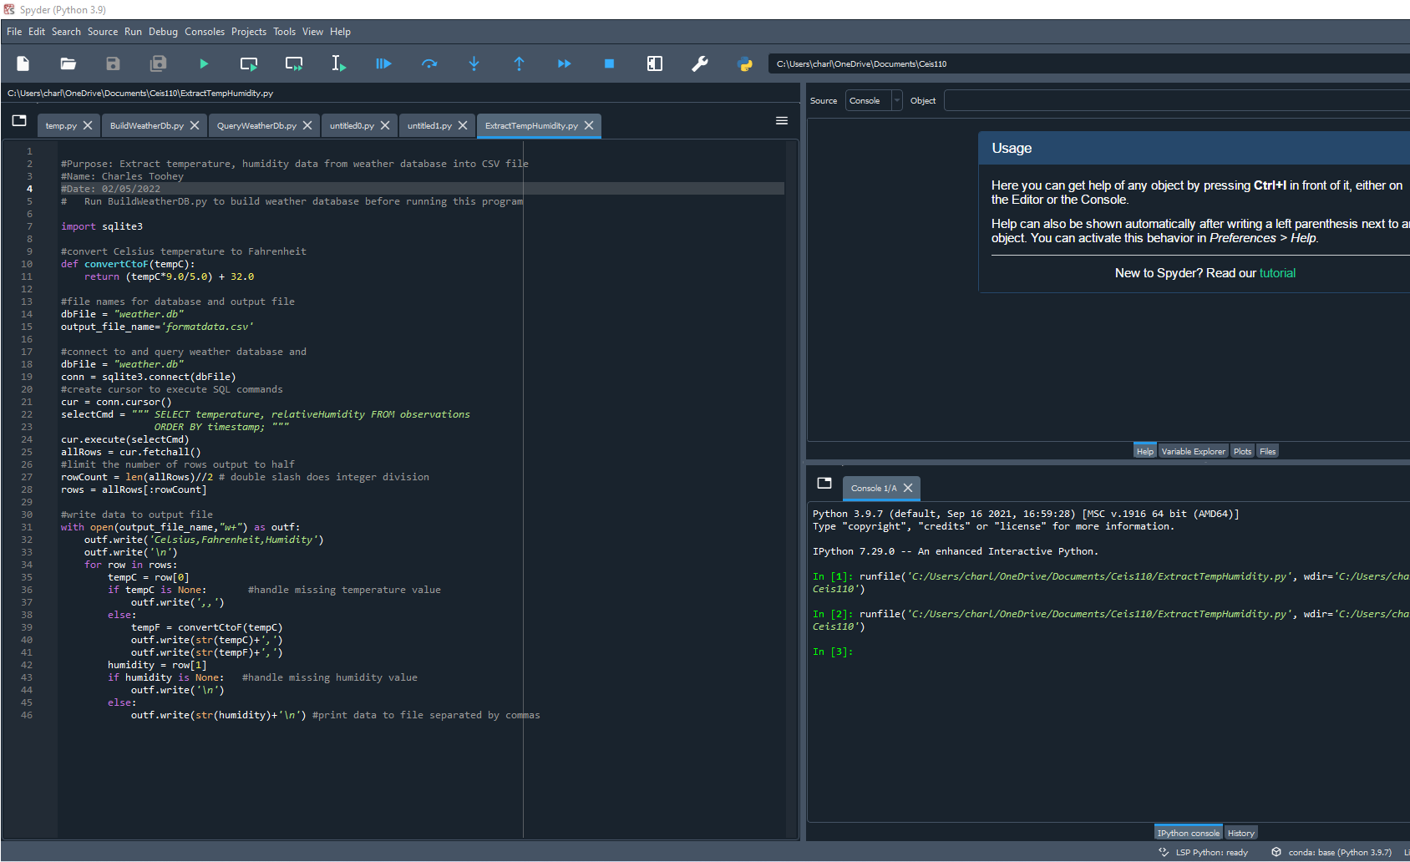
Extracting temperature and humidity using python code
The weather.db database may contain null or missing values. The code used to retrieve only the temperature and humidity values and writes them to a comma separated file (CSV) file.
two files are created, formatdata2.csv and formatdata.csv that each contain half of the rows.
Missing or invalid values are not written to the file.

Slide 16
Data formatted in an Excel spreadsheet
The Python program created a formatdata.csv file
The file contains 3 collums: Celsius, Fahrenheit, and humidity.
Statistics can then be performed on this spreadsheet.

Slide 17
Data visualization
A line chart was developed in Excel showing the temperature and humidity over period 1

Slide 18
Data analytics
Python data analytics modules allow users to develop charts and graphs depicting data.
The data sets can be manipulated as well as saved into tabular format.
The data analytics modules are available as part of anaconda.
Several plot charts were generated looking at humidity and temperature.
Then a prediction was made about the data.

Slide 19
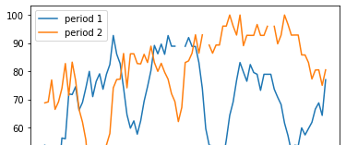
Charts

Slide 20
Analysis
The next step in analysis is developing a question and reviewing the data to answer the question. A chart can be used to visualize the data.

Slide 21
Code
#Purpose: Create box plot for period 2 data
#Name: Charles Toohey
#Date: 02-13-2022
import pandas as pd
import matplotlib.pyplot as plt
df2 = pd.read_csv("formatdata2.csv")
df2.boxplot(); plt.suptitle('Period 2 box plot')
plt.show()
print(df2.info())
print(df2.describe())
print("The median is",df2.median())

Slide 22
Prediction
Develop a prediction based on the data. What variations in temperature and humidity do you expect over the next few hours or days? How would humidity change if temperature goes up or down?
Based on the data that has been provided in the charts previously noted it is in my own opinion that over the next few months we will see slight increases in temperature. With this change in temperature, the graph also shows that we should expect a decrease in the humidity based on previous data.

Slide 23
Challenges
Some of the challenges that I have encountered in this journey would have to be making sure everything was organized properly in the class folder to be able to have everything work together because the database had to be in the same file, and I was having trouble at first before I realized the mistake.
Another challenge was the Excel program, I have not had to use a spreadsheet in many years so working with Microsoft excel for the first time since high school was a little challenging at first.

Slide 24
Career skills
Several career skills are gained in this project:
Communication- using flowchart to depict our plan for the project
Database development
Programming using python
Troubleshooting errors in code and data cleansing.
Analysis- reviewing charts and graphs to make predictions on data.

Slide 25
Conclusion
This project covers many fundamental topics of programming with data by using data gathered from a cloud service to perform data analytics operations.
Building this project provided a hands-on learning experience to put into practice the topics covered in this course.

Slide 26
Thank you all!
, Charles Toohey.

