Slide 1
Course Project
Operating Systems
Module 2 Linux Filesystem Hierarchy

Slide 2
Navigate the Linux filesystem tree
1. What is the pwd command an acronym for? What about the cd command?
Answer here:
Print working directory
Change directory
2. Explain the differences between a relative path and an absolute/full path in Linux.
Answer here:
Absolute-contains root element and complete directory list to find the file
Relative-needs to be combined with another path in order to find the file
References:
1.oracle
2.Youtube videos

Slide 3
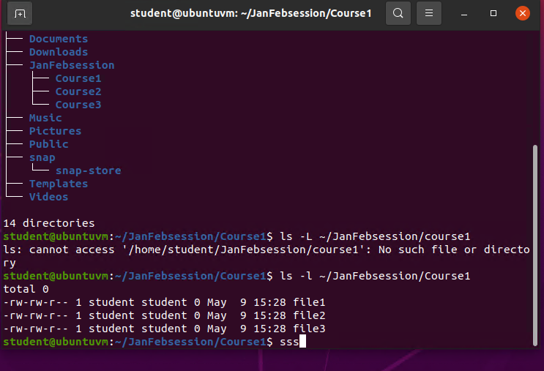
Create directories and files
Take a screenshot of the output in Steps 5 and 6.

Slide 4
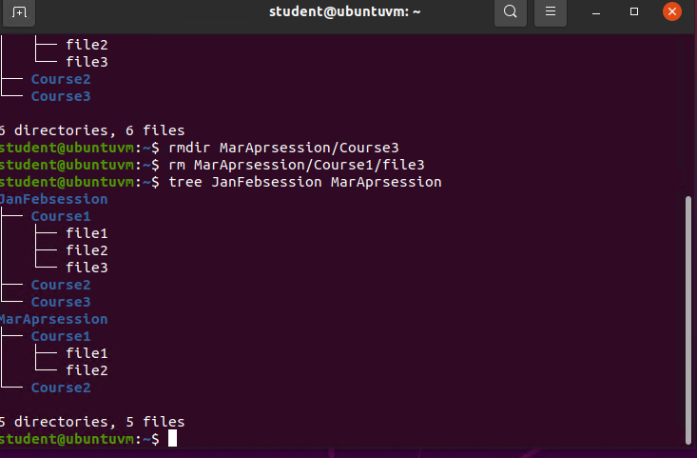
Copy and remove directories and files
Take a screenshot of the output in Step 3.

Slide 5
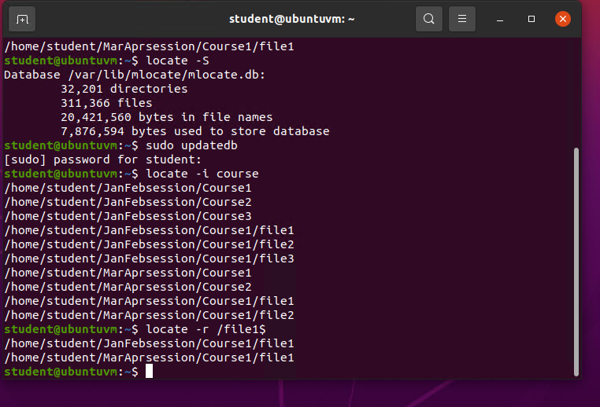
Locate directories and files
Take a screenshot of the output in Steps 5 and 6.

